Slide 1
Update

Slide 2
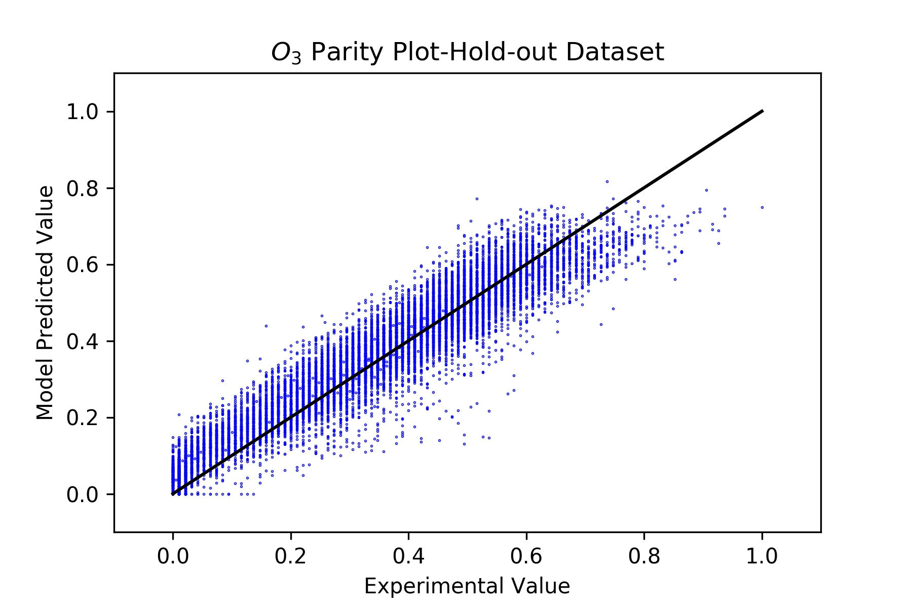
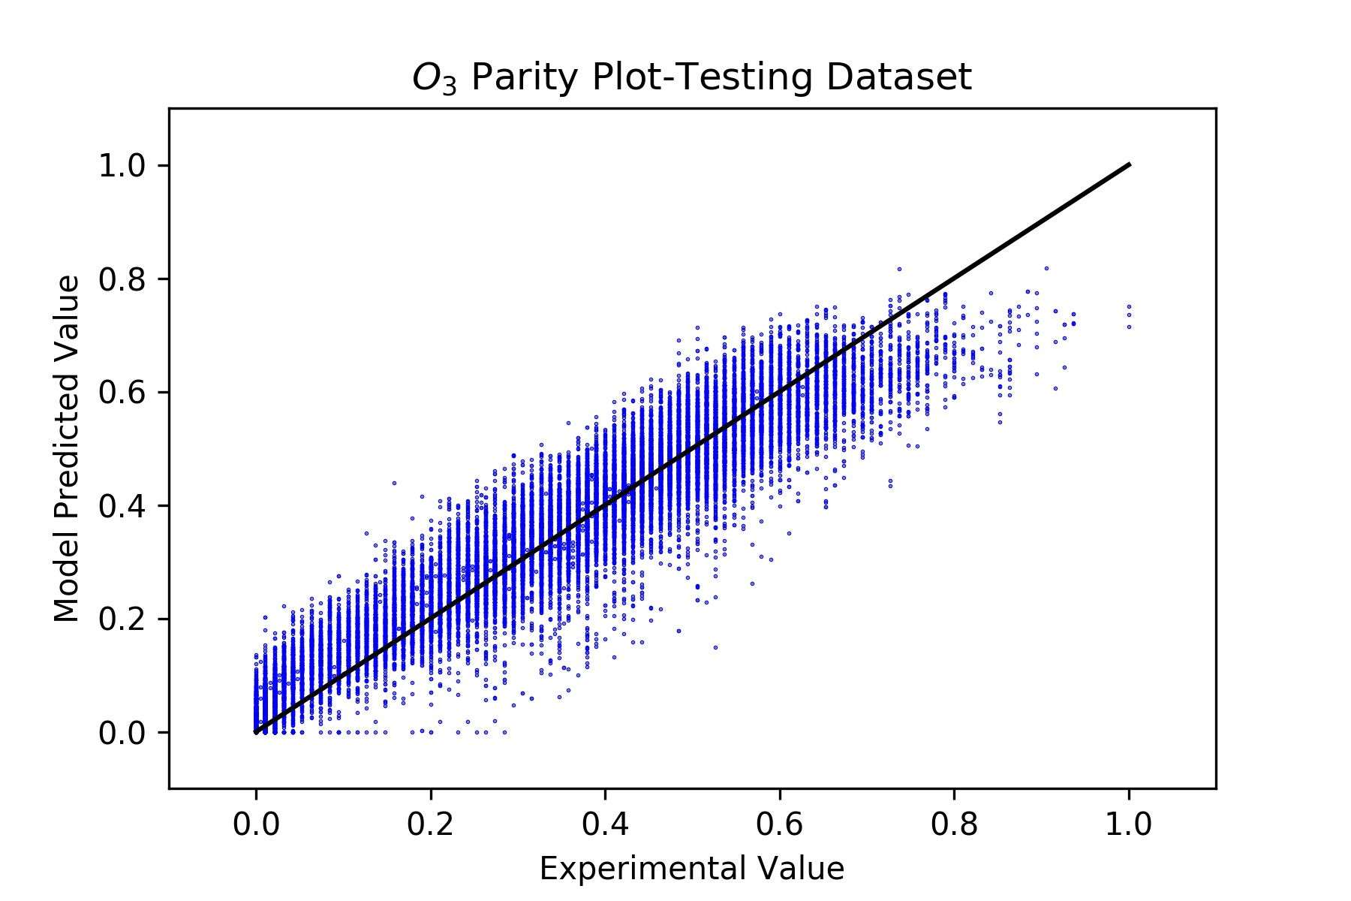
Requests Finished
Changed title of “other” to “hold out”
Changed title of “validation” to testing

Slide 3
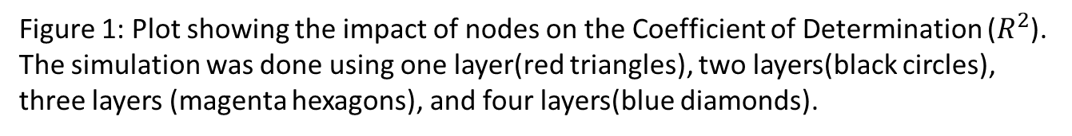
Layers Study
In the presentation, I prepared, this was included…one layer is best. If would you are worried about overfitting you can try 10 or 20
Figure 1: Plot showing the impact of nodes on the Coefficient of Determination ($R^{2}$).
The simulation was done using one layer(red triangles), two layers(black circles), three layers (magenta hexagons), and four layers(blue diamonds).

Slide 4
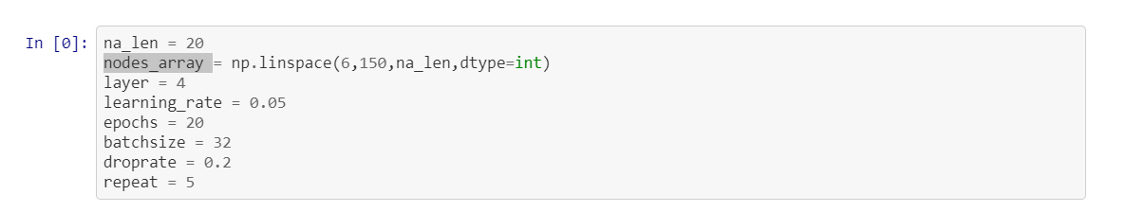
Layers Study
Code base already is able to test and will actually output a datafile just need to input layers and nodes:
In the example: ANNs with 6-150 nodes were tested with 4 layers

